Slide 1
Logistics: Project
Project presentation
Dec 6/8 during lectures
Everyone is expected to attend both lectures
10 minutes for presentation + 1~2 minutes for QA and transition
Project reports
Due: Dec 9 (no late submissions)
Up to 6 pages (plus additional pages for only references/citations)
No strict format requirements
You are encouraged to use standard templates
Check Piazza posts for details/updates

Slide 2
Assignment 4
No class on Nov 22, next Tuesday
Instead, I’ll give a list of talks/tutorials relevant to this course.
Choose one of them, watch the content, and write a report
The report needs to be no less than 2 pages, with any reasonable format
The report will serve as your assignment 4
Check the list of talks on Piazza

Slide 3
Peer Review
Please submit the peer review by 6pm

Slide 4
Lecture 21 Interpretable/Intelligible Machine Learning
Instructor: Chien-Ju (CJ) Ho

Slide 5
Who Need Explanations and Why?
Developers:
Debug the machine learning models and improve robustness
Users:
More likely to trust the models and act based on the predictions
Government:
By law, many consequential decisions (medical, financial, etc) need to be explainable
Society:
Help uncover the biases hidden underneath the predictions

Slide 6
How to Achieve Interpretability?
[Kim and Doshi-Velez. 2017]

Slide 7
How to Achieve Interpretability?
[Kim and Doshi-Velez. 2017]

Slide 8
How to Achieve Interpretability?
[Kim and Doshi-Velez. 2017]

Slide 9
Before Building a Model
Exploratory Data Analysis

Slide 10
Before Building a Model
Exploratory Data Analysis

Slide 11
Before Building a Model
Datasheets for datasets [Gebru et al. 2018]

Slide 12
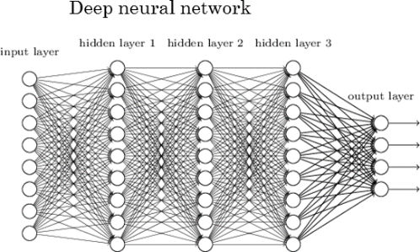
Develop an “Explainable” ML Model
Black-box approaches are hard to explain

Slide 13
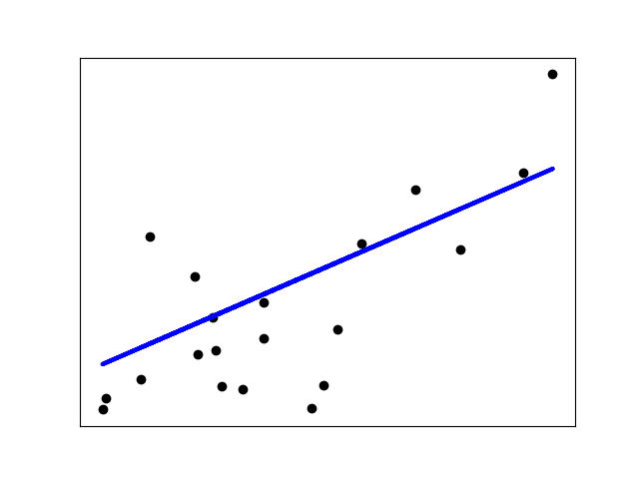
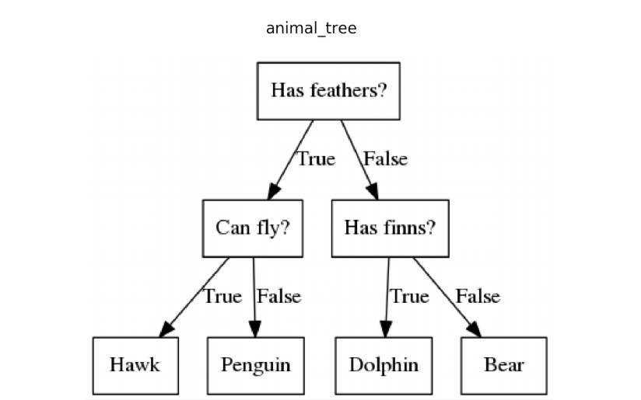
Develop an “Explainable” ML Model
Black-box approaches are hard to explain
Classical white-box approaches: linear models, decision trees,…

Slide 14
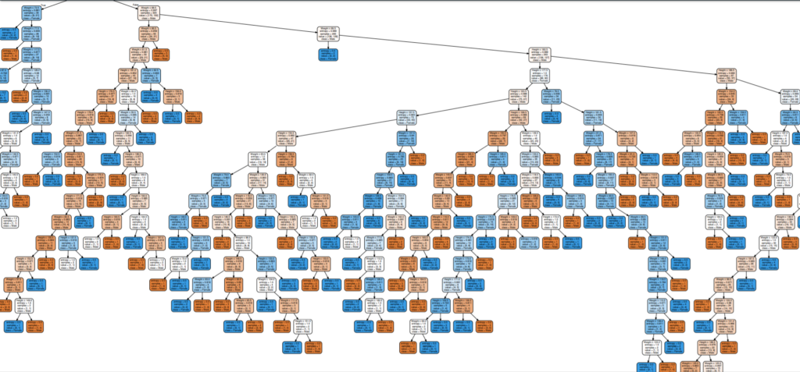
Develop an “Explainable” ML Model
Black-box approaches are hard to explain
Classical white-box approaches: linear models, decision trees,…
The difference is not always clear

Slide 15
Post-hoc Process
LIME [Ribeiro et al. 2016]
SHAP [Lundberg and Lee. 2017]

Slide 16
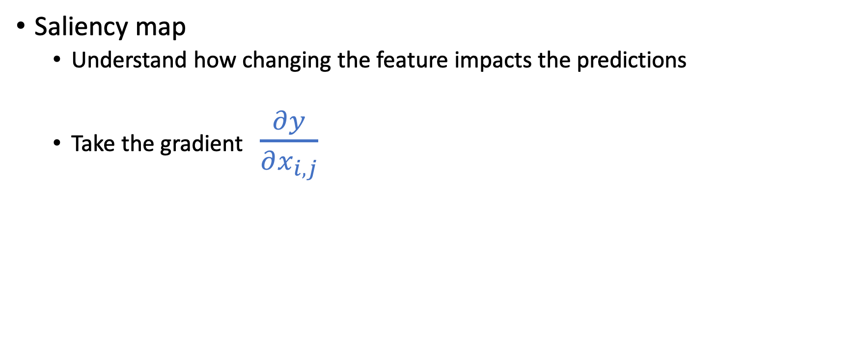
Post-hoc Process
Saliency map
Understand how changing the feature impacts the predictions
Take the gradient $\frac{∂y}{∂x_{i,j}}$

Slide 17
Post-hoc Process
Saliency map

Slide 18
Who Decides Whether Explanations Make Sense?
Humans make the call

Slide 19
Who Decides Whether Explanations Make Sense?
Humans make the call (Which humans?)
Humans’ mental models of AI
We have talked about modeling human behavior in this course
Maybe we want to model how human models AI’s behavior
We’ll talk a little bit about these in the lecture next lecture

Slide 20
Concerns of Interpretability?
Being interpretable
=> humans understand how AI operate
=> humans might want to alter the data to algin with their needs
=> ”Gaming”, or manipulation issue

